Slide 1
AI Supercharging Purple Teams
Sean Wong
2025/08/06

Slide 2
CONTENT
01
AI Purple-Team Vision
02
Smart Test Design
03
Real-Time Correlation
04
Coverage Analytics
05
Detection Engineering
06
Continuous Validation

Slide 3
CONTENT
01
02
Knowledge & Reporting
Workshop & Adoption

Slide 4
01
AI Purple-Team Vision

Slide 5

AI Tightens the Emulate-Detect Loop
01
Accelerated Cycle
AI accelerates the purple team cycle by auto-mapping ATT&CK, correlating telemetry, and drafting reports. This allows human experts to focus on validation, tuning, and strategic risk decisions.
02
Real-Time Feedback
Purple teaming benefits from AI’s ability to provide real-time feedback on red-team actions and blue-team detections, enabling faster iteration and improvement.
03
Continuous Improvement
AI enables continuous improvement by tightening the loop between emulation and detection, ensuring that defensive strategies are always up-to-date with the latest threats.
汇报人：xxx 汇报时间：x年x月x日

Slide 6
Human-AI Partnership in Purple
Algorithmic Data Crunching
AI handles data-intensive tasks like telemetry correlation and coverage gap analysis, freeing human experts to focus on strategic decisions and ethical considerations.
Ethical Boundaries
Humans retain control over test approval, detection refinement, and ethical boundaries, ensuring that AI augments collaboration without engaging in unauthorized actions.

Slide 7
02
Smart Test Design

Slide 8
01
Threat-Informed Scenarios
02
MITRE ATT&CK Alignment
AI tools like Caldera, PlexTrac, and AttackIQ generate threat-informed scenarios based on current intelligence, ensuring that purple team exercises are aligned with real-world threats.
AI maps proposed scenarios to the MITRE ATT&CK framework, ensuring comprehensive coverage of tactics and techniques relevant to the organization’s threat model.
AI Crafts Realistic Safe Scenarios
03
Scope Compliance
04
Ordered Test Plans
AI ensures that proposed scenarios comply with operational scope rules, preventing unauthorized actions and maintaining the integrity of the purple team exercise.
AI generates ordered test plans that prioritize high-impact techniques, enabling efficient use of resources and ensuring that critical gaps are identified quickly.

Slide 9

Coverage-Driven Test Selection
Prioritize Detection Gaps
AI models prioritize test cases based on detection gaps, ensuring that purple team efforts are focused on improving visibility and reducing residual risk.

Slide 10
03
Real-Time Correlation

Slide 11


Red Actions Blue Alerts Instantly Matched
Instant Correlation
AI tools like Elastic AI and Azure Sentinel automatically tag red-team actions with ATT&CK IDs and align them with blue-team alerts, providing real-time visibility into detection effectiveness.
Side-by-Side Timelines
AI generates side-by-side timelines of red-team actions and blue-team alerts, highlighting detection delays and enabling rapid tuning of defensive strategies.

Slide 12
Telemetry Gaps Surface Immediately
01
02
03
Part
Part
Part
One
One
One
Identify Missing Logs
Immediate Feedback
Enhanced Visibility
AI correlation engines identify missing telemetry logs from hosts, networks, or identities, prompting immediate action to deploy additional sensors or data filters.
By surfacing telemetry gaps in real-time, AI ensures that purple teams can address blind spots during the exercise rather than discovering them later.
AI-driven telemetry analysis enhances visibility across the environment, ensuring that all red-team actions are captured and correlated with blue-team detections.

Slide 13
04
Coverage Analytics

Slide 14
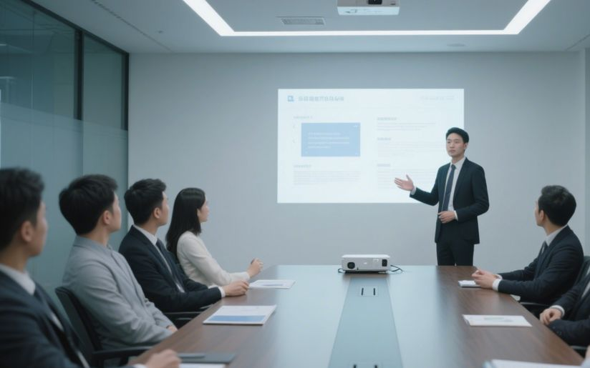
Heatmaps Visualize Detection Maturity
Visual Coverage Analysis
AI tools like Splunk AI and Chronicle generate heatmaps that visually represent detection maturity across the MITRE ATT&CK framework, helping prioritize engineering efforts.

Slide 15
Identify Redundant Rules
Recommend Cleanup Actions
Maintain Security Value
AI algorithms compare detection rules to identify redundant or noisy rules, reducing alert fatigue and improving SOC efficiency.
AI suggests cleanup actions such as merging or suppressing overlapping rules, ensuring that detection efforts remain focused and effective.
By identifying and addressing redundant rules, AI helps maintain security value while optimizing resource allocation and reducing operational costs.
Duplicate Noisy Rules Flagged for Cleanup

Slide 16
05
Detection Engineering

Slide 17


AI Drafts SIEM Rules from TTPs
Rule Drafting
Accelerate Development
AI assistants generate draft SIEM rules based on exercised TTPs, providing a starting point for blue teams to develop new detection logic.
AI-generated rule drafts accelerate the development process, allowing blue teams to quickly convert red-team findings into actionable detections.
汇报人：xxx 汇报时间：x年x月x日

Slide 18
False-Positive Forecast Before Deployment
01
Simulate Rule Execution
02
Avoid Alert Fatigue
AI models simulate rule execution against historical data to predict alert volume and false-positive ratios, helping tune rules before deployment.
By forecasting false positives, AI helps avoid overwhelming SOC analysts with unnecessary alerts, maintaining operational efficiency.
03
Prevent Detection Drift
04
Optimize Resource Allocation
AI ensures that detection rules remain effective over time by identifying and addressing potential drift before it impacts security posture.
Accurate false-positive forecasting allows for better resource allocation, ensuring that SOC teams can focus on high-value investigations.

Slide 19
06
Continuous Validation

Slide 20
Weekly Regression Tests Run Unattended
Automated Testing
Quantitative Drift Metrics
Prevent Silent Breaks
AI tools like SafeBreach and Caldera schedule and run weekly regression tests unattended, ensuring that existing detections remain effective over time.
AI provides quantitative metrics on detection drift, helping teams identify and address issues before they impact security posture.
Continuous validation ensures that hard-won detections do not silently break due to environment changes, maintaining robust defensive capabilities.

Slide 21

AI Rotates Scenarios by Risk Trend
Risk-Informed Rotation
AI analyzes risk trends to recommend the next techniques for validation, ensuring that continuous validation remains aligned with emerging threats.

Slide 22
07
Knowledge & Reporting

Slide 23

Auto After-Action Summaries
Clustered Findings
AI tools like Confluence AI cluster findings by tactic, severity, and affected asset class, producing concise after-action summaries that link gaps to recommended actions.
Accelerate Remediation
AI-generated summaries accelerate leadership approval for remediation resources, ensuring that identified gaps are addressed promptly.

Slide 24

Executive Briefings Translated Instantly
Risk-Oriented Briefs
AI converts technical timelines into risk-oriented briefs that quantify residual exposure, compliance impact, and budget needs, enabling C-suite decision-making.
Reduce Writing Burden
Ensure Clarity
Support Strategic Decisions
AI reduces the burden on analysts by generating executive briefings, allowing them to focus on high-value tasks rather than report writing.
AI ensures that technical details are translated into clear, understandable language for non-technical stakeholders, improving communication and alignment.
AI-generated briefings provide the necessary data to support strategic decisions, ensuring that leadership has the information needed to allocate resources effectively.

Slide 25
08
Workshop & Adoption

Slide 26
Task Triage Scoring Exercise
Identify AI Targets
Participants list purple-team tasks and score them based on data volume, correlation load, and documentation burden to identify prime AI augmentation targets.

Slide 27
Live Coverage Heatmap Build
01
Generate Heatmaps
Teams upload detection data into AI portals to generate live coverage heatmaps, identifying blind spots and assigning owners for rule development.
02
Immediate Action
AI enables immediate identification of gaps during exercises, allowing teams to take action before leaving the room, improving efficiency.
03
Enhance Collaboration
Live heatmaps facilitate collaborative discussions and decision-making, ensuring that all stakeholders are aligned on priorities.

Slide 28
Rule Draft Relay Race
Draft SIEM Queries
Benchmark Performance
Blue team members use AI to draft SIEM queries based on exercised TTPs, refining thresholds collectively to finalize detection rules.
AI benchmarks predicted false-positive rates against historical data, ensuring that new rules are effective and efficient.

Slide 29
Pilot-to-Scale Roadmap
Start with Low-Risk Automation
01
02
Expand to Other Areas
Begin with low-risk tasks like weekly regression tests, define baseline metrics, and run a pilot with volunteer engineers to capture ROI data.
After a successful pilot, expand AI to scenario design, correlation, and executive reporting while embedding continuous training.
Monitor and Optimize
03
04
Ensure Ethical Use
Continuously monitor AI performance and optimize processes to ensure long-term success and sustained improvement.
Maintain ethical use of AI by ensuring compliance with organizational policies and avoiding unauthorized actions.

Slide 30
THANK YOU
Sean Wong
2025/08/06

